Slide 1
Type 1 diabetes
and me
[Enter your name here]
[Enter the date here]

Slide 2





What is diabetes?
Diabetes happens when there’s too much sugar (called glucose) in your blood. We all get glucose from the food we eat, and it gives our bodies energy to move, think, and play.
To use glucose, our body needs insulin — like a key that opens the door to let glucose into our cells. Insulin is made by the pancreas, an organ near your tummy.
People with diabetes either don’t make insulin or it doesn’t work properly, so the glucose can’t get into the cells and stays in the blood.
Too much glucose in your blood can make you feel sick, and over time, it can hurt important parts of your body like your eyes, heart, and feet.
Notes:
What is diabetes?
Diabetes happens when there’s too much sugar (called glucose) in your blood. We all get glucose from the food we eat, and it gives our bodies energy to move, think and play.
To use glucose, our body needs insulin — like a key that opens the door to let glucose into our cells. Insulin is made by the pancreas, an organ near your tummy.
People with diabetes either don’t make insulin or it doesn’t work properly, so the glucose can’t get into the cells and stays in the blood.
Too much glucose in your blood can make you feel sick, and over time, it can hurt important parts of your body like your eyes, heart and feet.

Slide 3
About Me
I have type 1 diabetes and was
diagnosed at age [insert age].
[Talk about what happened when you were diagnosed – were any of the 4Ts present?]

Slide 4
My favourite things...
Even though I have type 1 diabetes, I can still do all the things I love.
[Insert photos of you doing your favourite things]

Slide 5
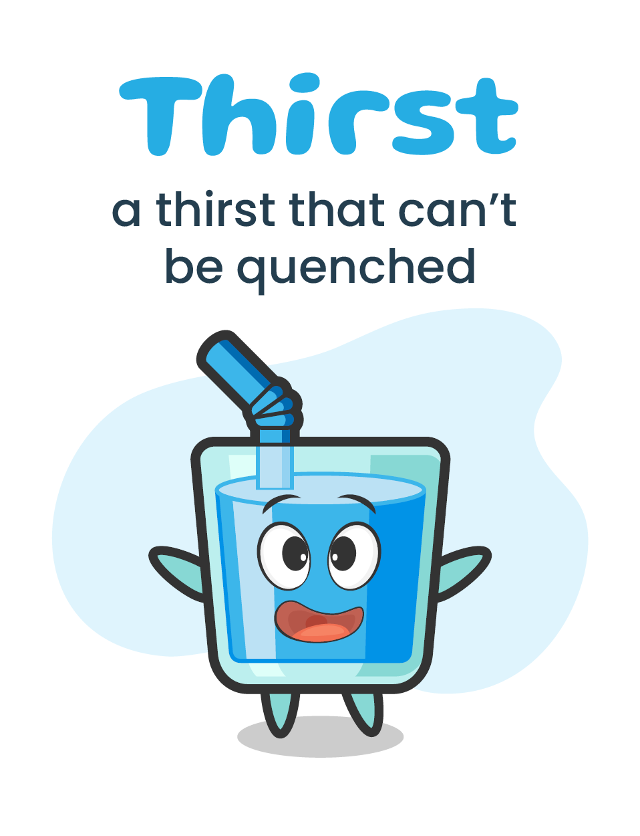
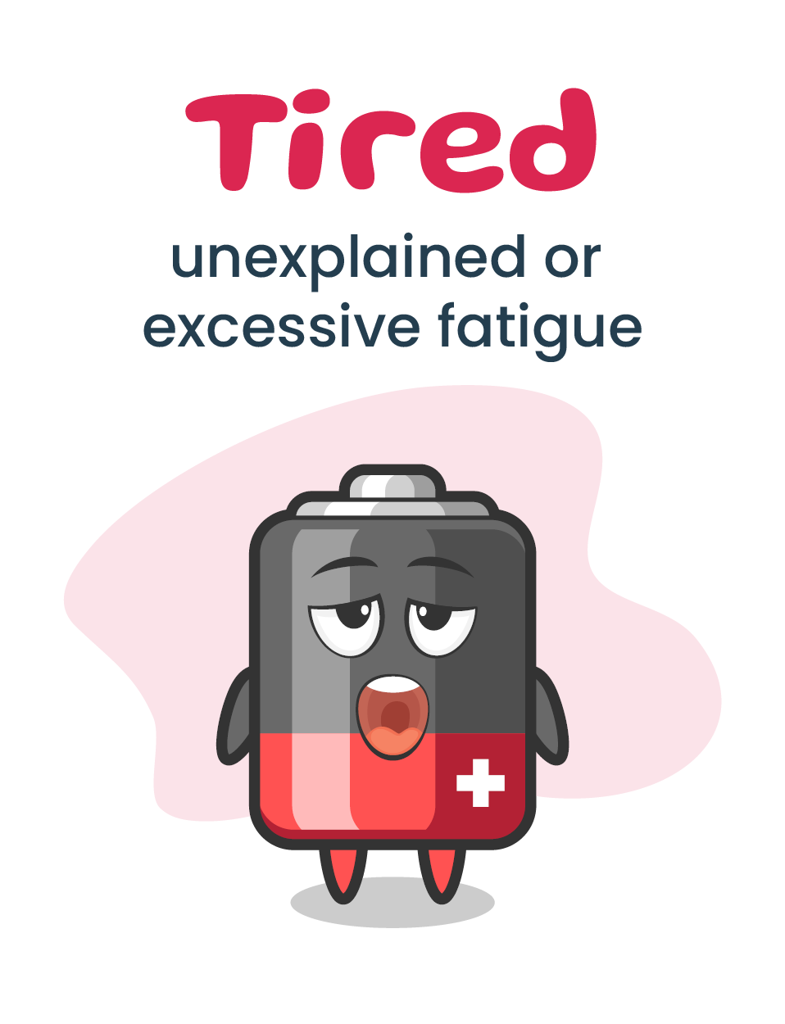
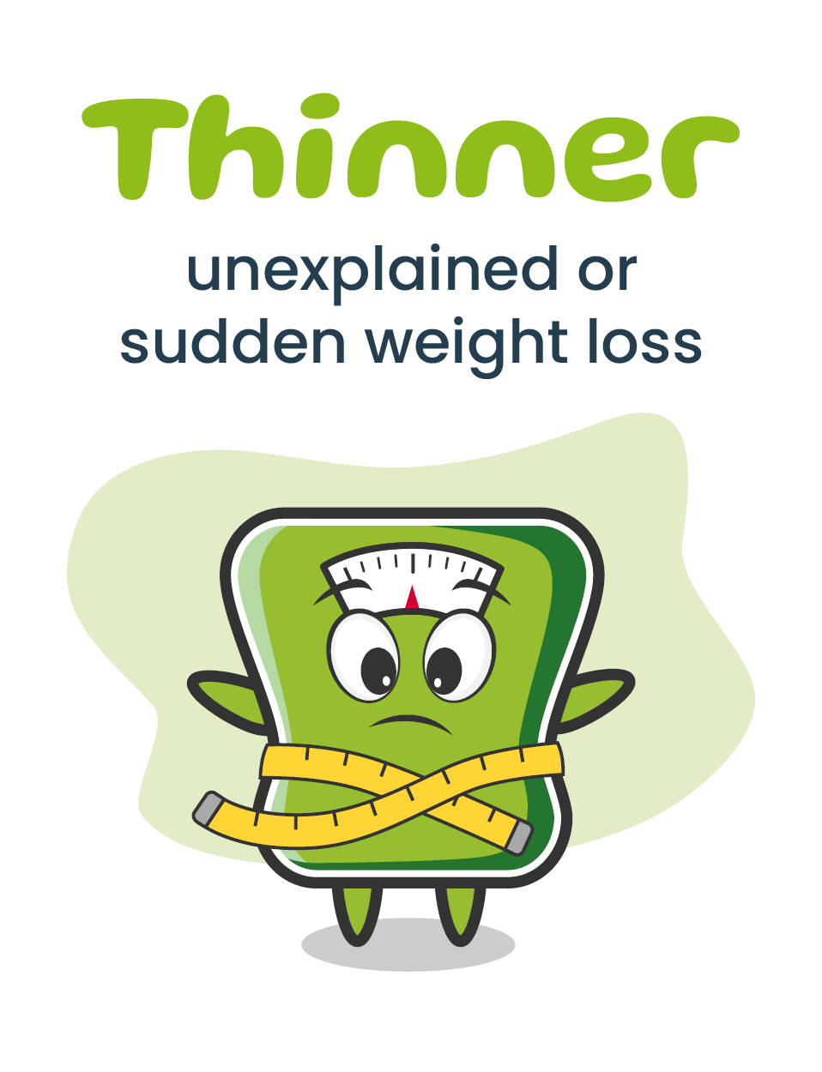
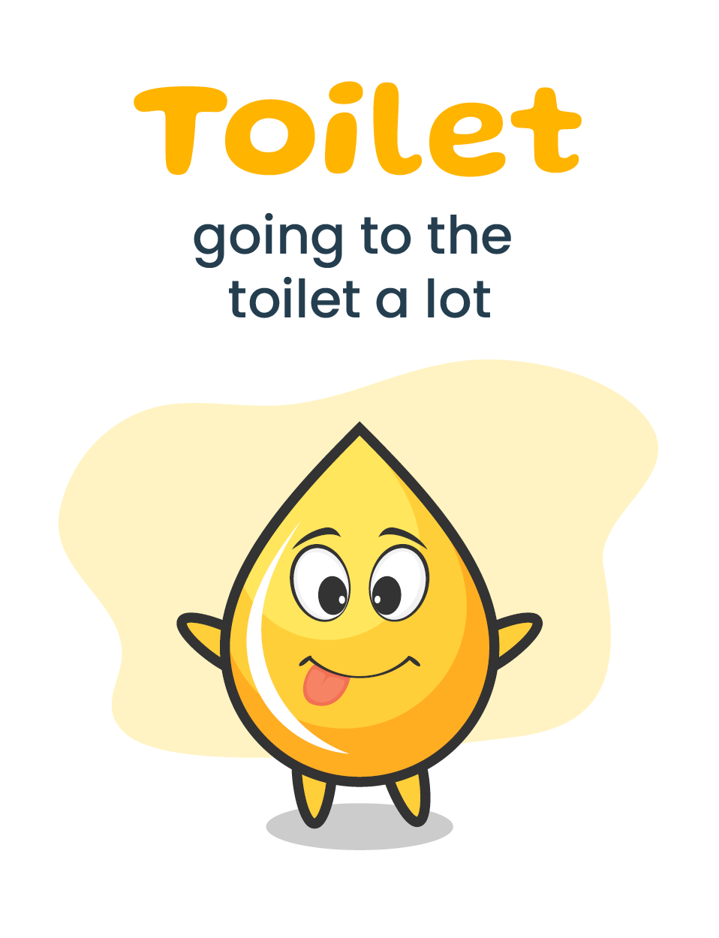
What are the 4Ts?
Because diabetes can develop quickly in kids, it’s important to know the early warning signs.
Learning the 4Ts only takes a moment and can save a life. If you see the signs, let your parents or carers know.
Notes:
Because diabetes can develop quickly in kids, it’s important to know the early warning signs.
What are the 4Ts?
Tired – unexplained or excessive fatigue
Thirsty – a thirst that can’t be quenched
Thinner – sudden or unexplained weight loss
Toilet – going to the toilet a lot
Learning the 4Ts only takes a moment and can save a life. If you see the signs, let your parents or carers know.

Slide 6






Thank you!

